Slide 1
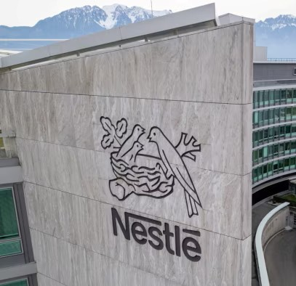
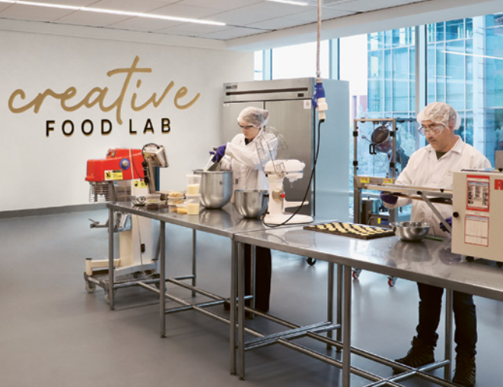
Nestle´s Operations: Strategies for Efficiency and Sustainability
sf
Arunima Bollampally

Slide 2
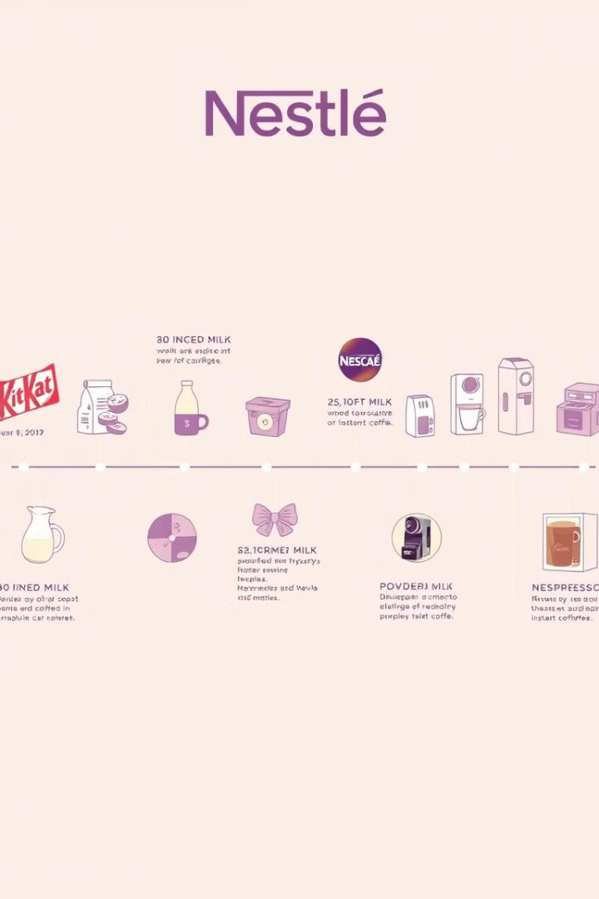
A Legacy of Innovation: 150 Years of Serving Consumers
Nestlé is a multinational food and beverage company headquartered in Switzerland. It is the largest food company in the world, with over 2,000 brands and a presence in over 190 countries.
1
Founded in 1866 by Henri Nestlé, the company began with infant formula and quickly expanded to other food and beverage categories.
2
Throughout the 20th century, Nestlé continued to grow and innovate, introducing iconic brands like Nescafé, Maggi, and Kit Kat.
3
Today, Nestlé remains committed to innovation and sustainability, developing products that meet the needs of evolving consumer preferences.

Slide 3
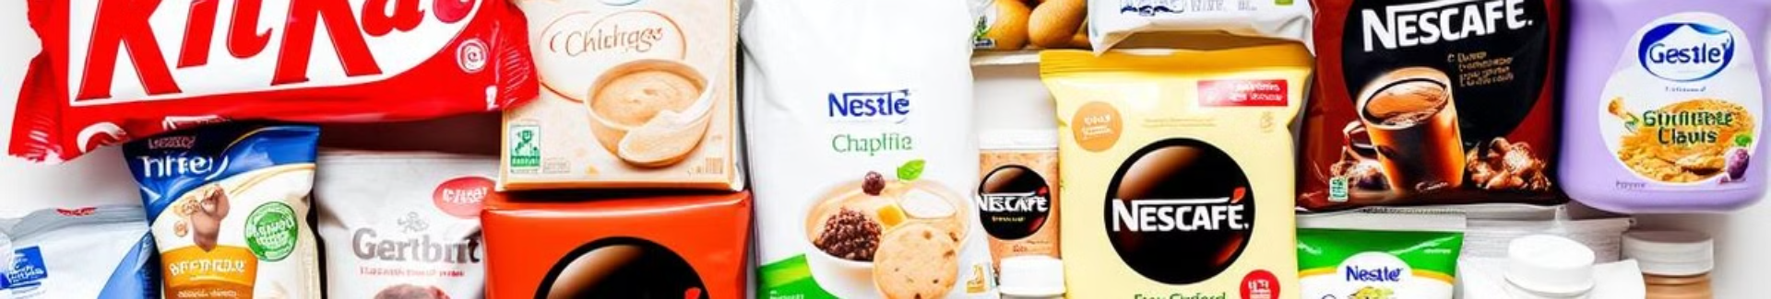
Diverse Brand Portfolio: From Iconic Confections to Cutting-Edge Nutrition
Chocolate & Confectionery
Coffee & Beverages
Nestlé's portfolio includes globally recognized brands like KitKat, Smarties, and Aero, loved by consumers of all ages.
From Nescafé to Starbucks, Nestlé provides a wide range of coffee and tea options for every taste and occasion.
Baby & Infant Nutrition
Plant-Based Alternatives
Nestlé's Gerber and NAN brands are recognized for providing high-quality infant nutrition products for healthy development.
Nestlé is committed to offering delicious plant-based alternatives for a more sustainable and ethical food system.

Slide 4




Innovation Driving Growth: Pioneering Research and Development
Science-Based Solutions
Nestlé invests heavily in R&D to develop innovative products that meet evolving consumer needs and address global challenges.
Health and Wellness
Nestlé's research focuses on developing healthier food and beverage options, promoting a balanced diet and active lifestyle.
Digital Transformation
Nestlé embraces technology to improve production processes, optimize supply chains, and create personalized consumer experiences.

Slide 5

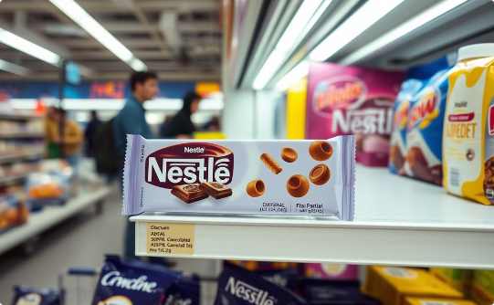

Global Reach, Local Relevance: Connecting with Consumers Worldwide
Global Presence
Local Adaptation
Building Relationships
Nestlé operates in over 190 countries, adapting its products and services to meet local needs.
The company tailors its products and marketing to different cultures and consumer preferences.
Nestlé works to build strong relationships with consumers and communities worldwide.

Slide 6
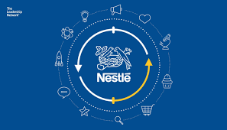
Overview of Nestlé's Operations: Opportunities & Challenges
Nestle is one of the largest food and beverage companies in the world
Nestle's Operations Managment: High-Quality products for all ages, with innovation and integration of sustainability
Aims to balance Growth and Market leadership with environment stewardship and social responsibility

Slide 7





Opportunities in Nestlé's Operations Management
Generative AI Integration
Sustainable Sourcing
NesGPT enhances employee training, productivity, and decision-making. AI analyzes consumer data for better demand forecasting and accelerates product innovation.
Nescafé Plan ensures climate-smart coffee sourcing. Cocoa Plan aims for 100% sustainable cocoa by 2025. Responsible fish sourcing for pet food production.
E-commerce Growth
Target of 25% from sales
Plant-Based Products
Circular Economy
Collaborations and Transparency
Garden Gourmet brand caters to vegan customers, capitalizing on the global trend of reducing meat consumption and reducing environmental impact.
Initiatives to reduce food waste, improve resource efficiency, and promote food upcycling. Biogas plant converts agricultural waste into renewable energy.
Transparency in Nutrition initiative ,WWF, Fairtrade International

Slide 8
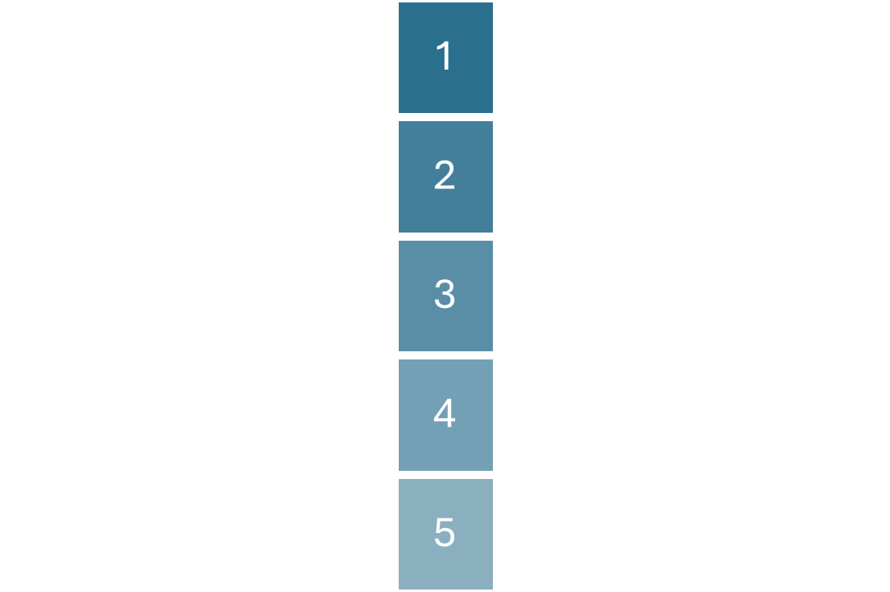
Challenges Faced by Nestlé's Operations
Complex Supply Chain Management
Spans 190+ countries, facing geopolitical instability and climate change impacts
Consumer Expectations
Demand for healthier, sustainable products requires continuous innovation
Sustainability goals
Target zero land fill , zero waste in packaging, 100% renewable electricity for its operations
Child Labour issues
Complexity in handling Human rights violation and child labour especially third world
Cost Pressures
Rising raw material costs (diary ,grains) and investments in sustainability initiatives
Nestlé faces additional challenges in technological integration, cultural differences, and balancing local preferences with global standards. These challenges require ongoing adaptation and strategic planning to maintain operational excellence.

Slide 9
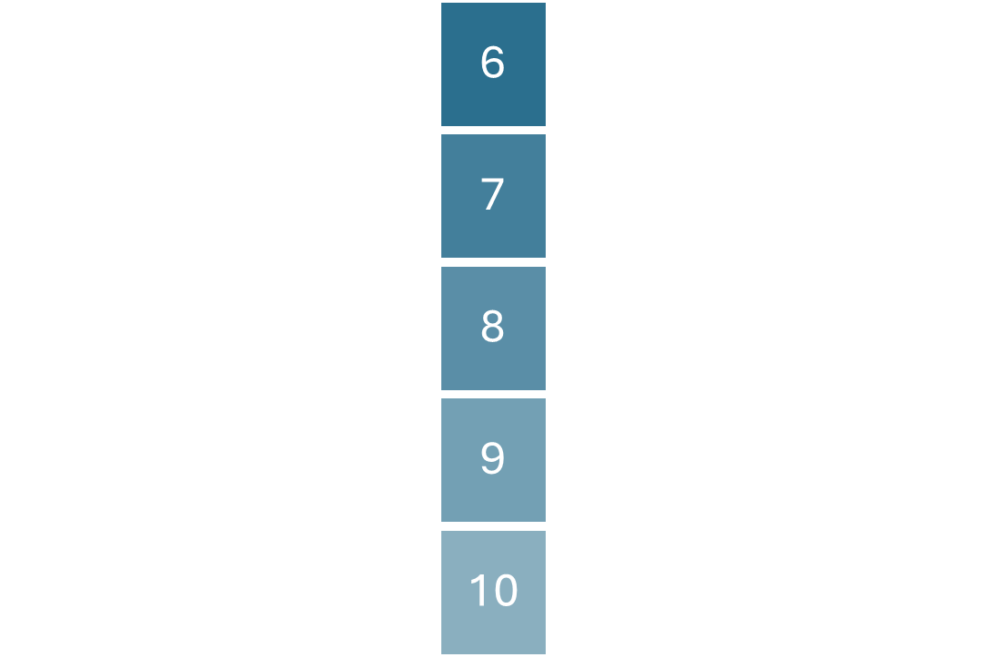
Challenges Facing Nestlé's Operations
Ineffective decision making models
Poor decision-making in operations effectiveness led to closure of UK plant, job losses, Brand reputation damage
Quality Complaints
Baby foods, Maggi in the past faced issue. Same product different variations in different regions
Regulatory Compliance
Navigating diverse food safety regulations and packaging standards globally
Technological integration
Resistance from employees due to unemployment fears
Innovation and Production
Rising raw material costs and investments in sustainability initiatives

Slide 10
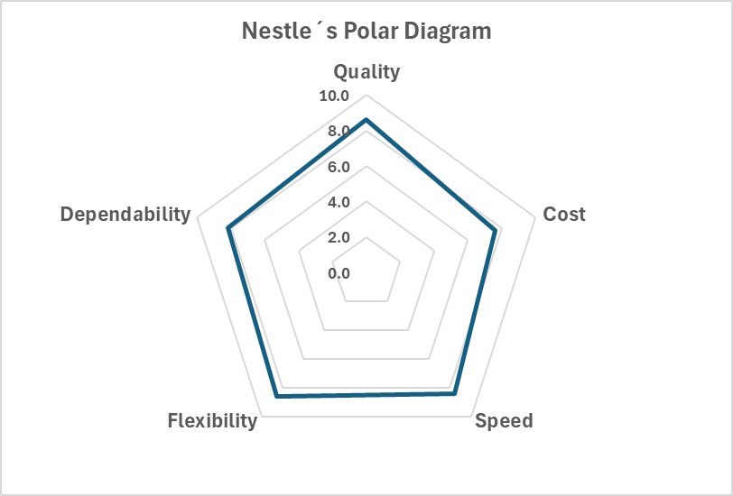
Nestlé Operations Analysis
Polar Diagram
4 V Profile
Volume
International presence of Nestlé is wide, supporting high production and distribution capacities. The company manages its supply chain skillfully to ensure the timely availability of its products in different markets. The scale allows Nestlé to maintain competitive prices while meeting consumers' demand in different parts of the world.
→High
Variety
The extensive range of products under Nestlé addresses the preferences of a wide spectrum of consumers across a variety of demographic groups. From instant noodles to high-end coffee, Nestlé has so many choices that resonate with different palates and lifestyles. This diversity increases consumer satisfaction and enables the brand to be able to communicate with more people.
→High
Variation
By maintaining an extensive product portfolio, localizing offerings, innovating continuously, and employing strategic promotions, Nestlé enhances its market presence and strengthens its competitive advantage in the global food industry.
Overall, a balanced performance with high scores.
→High
Visibility
The Transporeon Visibility Hub helps Nestlé handle uncertainties and respond quickly in unstable situations. It will also help Nestlé track where the products and raw materials are manufactured and how they reach the consumer. In this way, Nestlé can meet the demand from consumers who are interested in food safety and sustainability.
Challenge: Risk of unsold or discarded products with short shelf life
→High

Slide 11
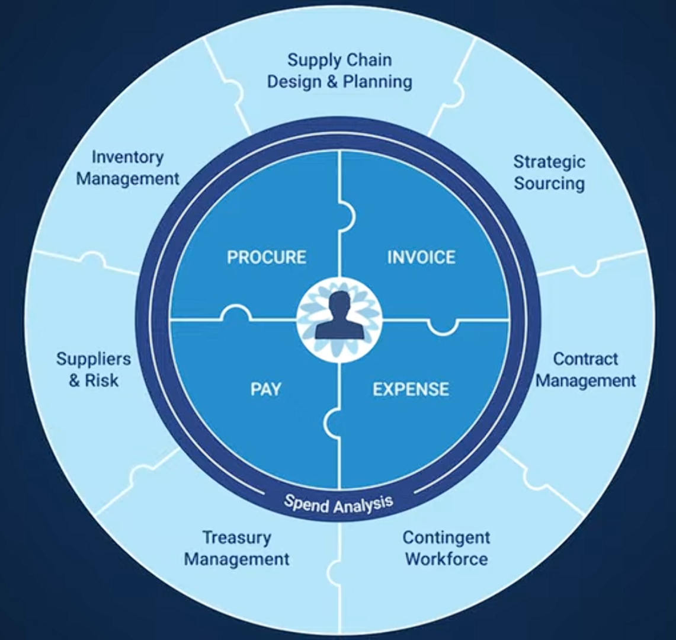
Forecasting
Inventory Management
Nestlé divides its demand planning and time series analysis work into four broad horizons
Nestlé worked with solution provider Coupla, A data-driven approach was taken to evaluate replenishment lead times, improve data, and improve forecasting accuracy. As a result, replenishment times have been reduced, safety stock has been optimized, and financial savings have been realized.
Executional horizon: Looking 1-6 weeks out to ensure product availability.
Operational horizon: Projecting the next 7-26 weeks to align and sign off business plans.
Tactical horizon: Planning for the next 7-18 months to prepare tactical resources.
Strategic horizon: Advanced planning beyond 18 months to design networks and production capacity.
Nestlé automates 80% of forecasting
Reduced safety stock by 14-20% and achieved cost savings of up to $20 million (on $100 million in inventory)
Source : Coupa Software
Challenge: Quicker AI response to uncertainty

Slide 12
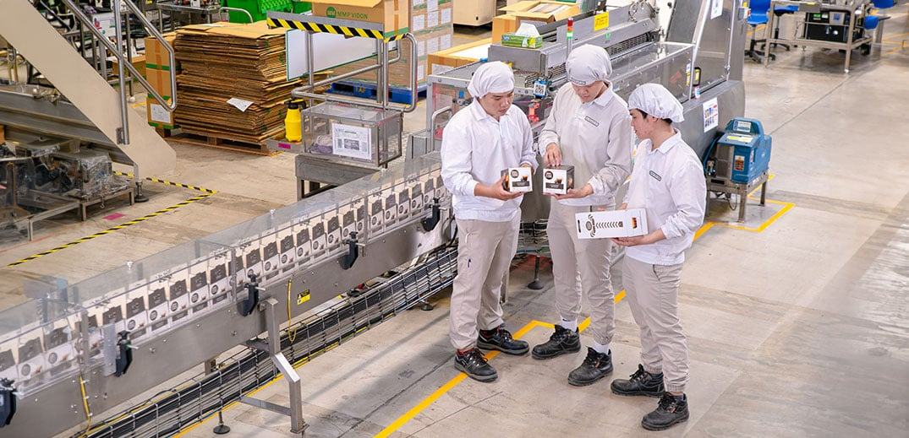
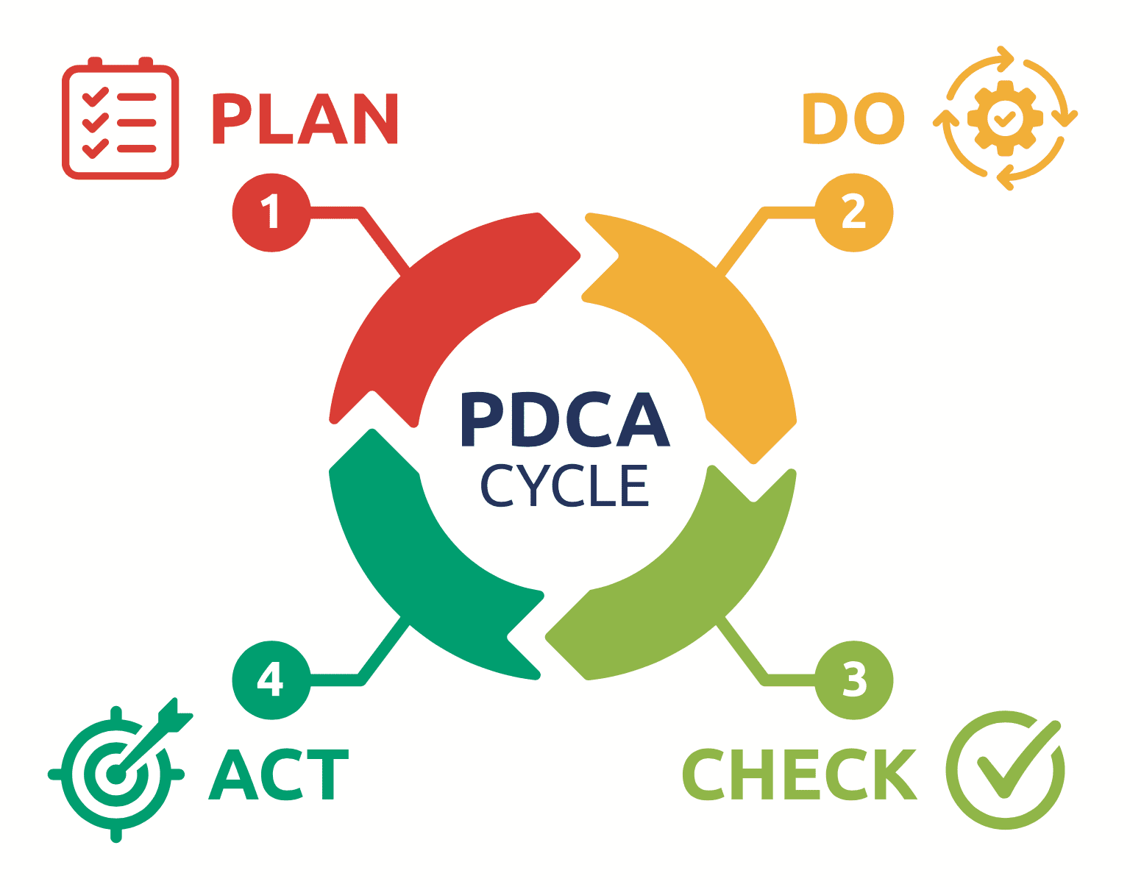
Quality Improvement Tools : TQM Implementation
Customer Focus
Continuous Improvement
Nestlé prioritizes understanding and meeting consumer needs. This commitment is reflected in its quality policy, which emphasizes delivering products that meet or exceed customer expectations.
Nestlé employs a continuous improvement cycle that involves regularly assessing and refining processes. This is supported by data-driven decision-making and the use of performance metrics.
Sustainable Sourcing
Monitoring and Reporting
Nestlé collaborates with farmers and suppliers to promote sustainable agricultural practices. By integrating sustainability into its supply chain, the company ensures the quality of raw materials while supporting local communities.
Nestlé employs rigorous monitoring systems to track progress towards its sustainability goals. This includes regular reporting on key performance indicators related to environmental impact and social responsibility.
Challenge: Fear that the TQM implementation cycle may not be quick enough due to the fact that it is a global company.

Slide 13
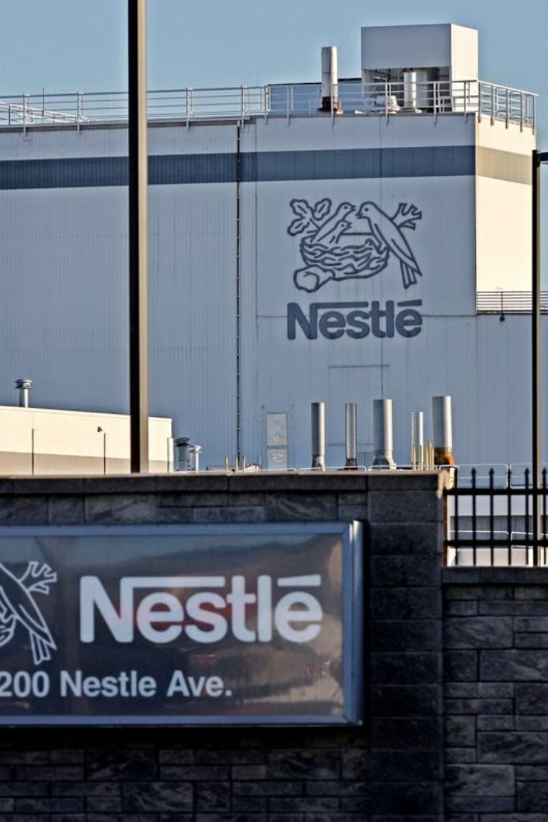
Recommendations for Sustainable Growth
Nestlé, a global leader in food and beverage, faces a dynamic environment of evolving consumer preferences and heightened sustainability expectations. This presentation outlines key improvement recommendations to strengthen Nestlé's operations, enhance its competitiveness, and foster sustainable growth.

Slide 14
Strengthening Sustainable Sourcing Practices
What?
Why?
How?
Nestlé must prioritize sustainable sourcing of raw materials like cocoa, coffee, and palm oil, ensuring practices that mitigate environmental harm, uphold labor rights, and enhance supply chain resilience.
Nestlé's reliance on global supply chains exposes it to risks such as deforestation, soil degradation, and unethical labor practices. These challenges threaten the sustainability of its operations and damage its brand reputation.
Nestlé can implement a multi-pronged approach: collaborate with suppliers to adopt sustainable farming techniques, invest in traceability systems to monitor supply chains, and establish clear sustainability standards with third-party certifications.

Slide 15
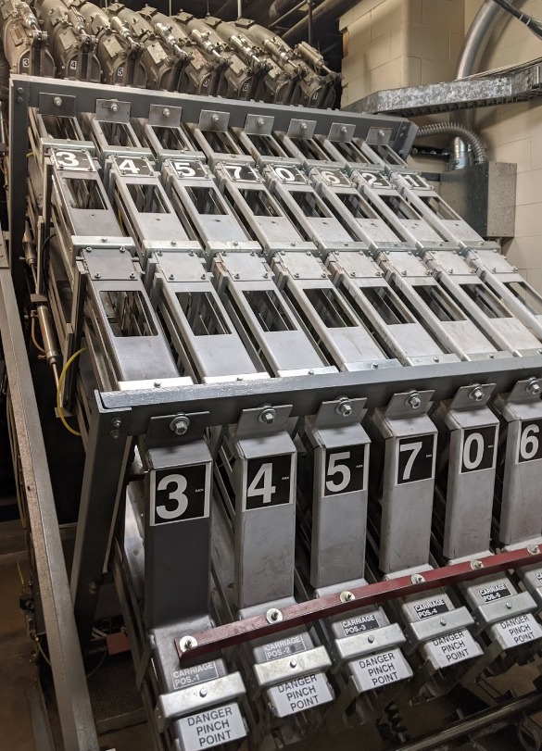
Supply Chain Optimization
What?
Why?
Leverage advanced analytics tools and technologies to monitor and predict supply chain activities, enabling better decision-making and risk management.
Global supply chain disruptions, including those caused by the COVID-19 pandemic, have demonstrated the importance of agility in supply chain operations.
How?
Nestlé can implement a comprehensive strategy involving the integration of advanced analytics platforms, real-time data visualization dashboards, and predictive modeling techniques. This approach will enable proactive identification of potential disruptions, optimize inventory management, and improve forecasting accuracy, enhancing overall supply chain efficiency and resilience.

Slide 16

Addressing Packaging Waste
What?
Why?
Shift to a circular economy framework that minimizes waste and maximizes the reuse and recycling of materials, particularly in packaging.
Packaging waste represents a significant environmental challenge, with increasing consumer and regulatory demands for sustainable alternatives.
How?
Nestlé can implement a multi-pronged approach: invest in innovative packaging solutions using recycled materials, partner with recycling facilities to improve waste management systems, and educate consumers about proper recycling practices. Promote reusable packaging options and explore initiatives for closed-loop systems where materials are perpetually recycled.

Slide 17
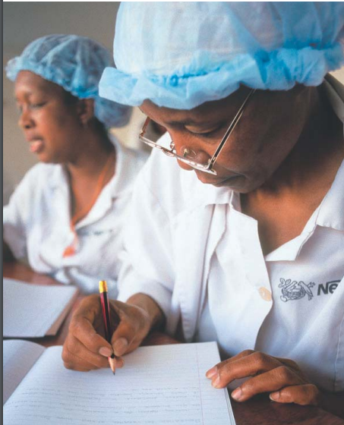
Enhancing Workforce Training and Development
What?
Why?
How?
Develop a comprehensive workforce training program focused on sustainability, lean operations, and advanced analytics.
Upskilling the workforce ensures Nestlé remains competitive, improves operational efficiency, and promotes a culture of continuous improvement.
Implement a multi-phased approach:
1. Develop centralized online training platforms;
2. Offer incentives like certifications and career advancement opportunities;
3. Start with pilot programs and gradually expand based on results.

Slide 18
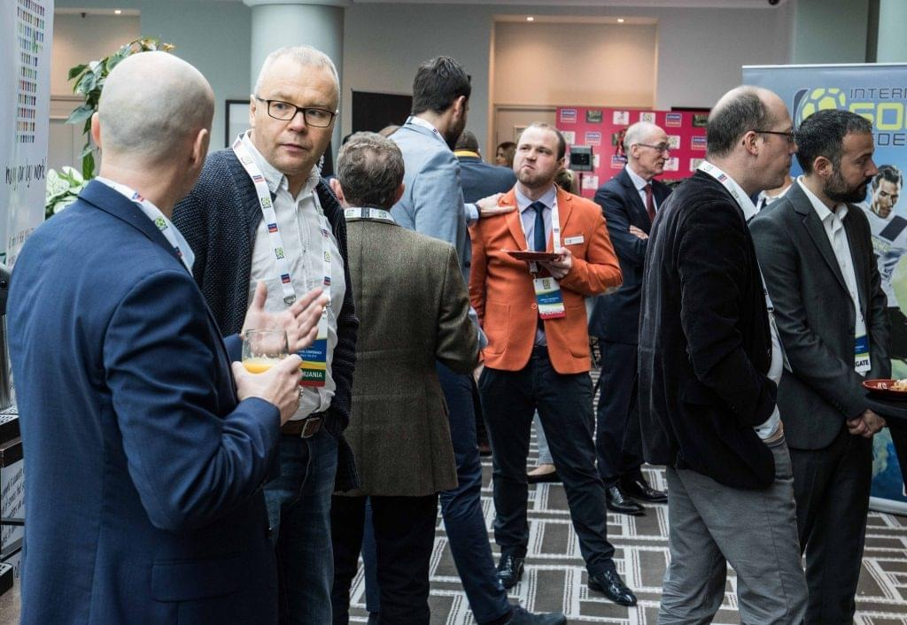
Collaborating with More Startups for Innovation
What?
Partner with innovative startups specializing in plant-based products, sustainable packaging, and green energy solutions.
Examples: Good Catch: A, TurtleTree Labs: and Benevolent AI:
Why?
Drive innovation and accelerate the development of sustainable and environmentally friendly products and processes. Leverage external expertise and resources to enhance Nestlé's sustainability initiatives.
How?
Identify promising startups , establish clear collaboration frameworks (including IP sharing and data privacy agreements), launch pilot projects to test new technologies, and scale successful initiatives globally.

Slide 19



Building a Sustainable Future for Nestlé
Nestlé's journey toward sustainability requires a proactive approach, encompassing the entire value chain and leveraging the power of innovation and collaboration.
By embracing these recommendations, Nestlé can position itself as a leader in responsible business practices, fostering long-term growth and contributing to a more sustainable future.

Slide 20



Key Takeaways
Sustainability
1
Nestlé must prioritize sustainable sourcing, circular economy practices, and workforce development.
Innovation
2
Partnering with startups and leveraging advanced technologies can drive innovation.
Collaboration
3
Engaging with stakeholders, including suppliers, NGOs, and government agencies, is crucial.

Slide 21
Next Steps
Action Plan
1
Develop a comprehensive action plan outlining specific initiatives and timelines for implementing these recommendations.
Resource Allocation
2
Secure the necessary resources, including budget, talent, and partnerships, to support these initiatives.
Performance Monitoring
3
Establish key performance indicators (KPIs) to track progress, measure impact, and make necessary adjustments.

Slide 22
References:
About us. (2024). Nestlé Global; Nestlé. https://www.nestle.com/about
Bolen, A. (2023, May 24). Don’t miss these demand planning tips from Nestlé - SAS Voices. SAS Voices.
https://blogs.sas.com/content/sascom/2023/05/16/demand-planning-tips-from-nestle/
Büchel, B., & Zintel, C. (n.d.). Nestlé Continuous Excellence: Lessons for driving Performance improvement.The European Financialreview. https://www.europeanfinancialreview.com/nestle-continuous-excellence-lessons-for-driving-performance-improvement/
Chopra, S., & Meindl, P. (2020). Supply Chain Management: Strategy, Planning, and Operation (7th ed.). Pearson Education.
Deming, W. E. (1986). Out of the Crisis. MIT Press.
Ellen MacArthur Foundation. (2023). Towards a Circular Economy: Business Rationale for an Accelerated Transition. Retrieved from https://ellenmacarthurfoundation.org
Gandhi, O. A. (2024, February 11). Company analysis on “Nestle.” https://journal.ijresm.com/index.php/ijresm/article/view/2932
Gedela, R., & Jaladi, R. (2012). Total Quality Management in Nestle [Journal-article]. Department of Commerce and Management Studies, 9–11. http://www.ijrms.com/olvolume2issue6/GedelaRakeshVarma-JaladiRavi-2.pdf
Harvard Business Review. (2022). Managing Disruption in Global Supply Chains. Retrieved from https://hbr.org

Slide 23
Jakubavičius, A., & Burinskienė, A. (2024). Non-alcoholic drinks supply chains: case of Nestle and Coca-Cola and their contribution analysis during COVID-19 period. https://etalpykla.vilniustech.lt/handle/123456789/154829
Man, R. (2012, October 11). Nestle drives better demand. Consumer Goods Technology. https://consumergoods.com/nestle-drives-better-demand
Marketing Explainers. (2024, November 18). Nestle’s Marketing Strategy Explained. https://www.marketingexplainers.com/nestles-marketing-strategy-explained/
McKinsey & Company. (2023). The State of Supply Chain 2023: Agility and Innovation. Retrieved from https://mckinsey.com
Nestlé Global Marketing Strategy: Key Approaches for Success in a Competitive Market – Latterly.org. (n.d.). https://www.latterly.org/nestle-global-marketing-strategy/
Our history. (2022). Nestlé Global. https://www.nestle.com/about/history
Pereira, D. (2024, August 29). Nestlé Marketing Strategy (2024). Business Model Analyst. https://businessmodelanalyst.com/nestle-marketing-strategy/
Perry, N. (2024, February 7). The Key to Inventory Optimisation at Nestle. Procurement. https://procurementmag.com/articles/the-key-to-inventory-optimisation-at-nestle
Pierce, F. (2020, May 17). How Demand-Driven forecasting paid off for Nestle. supplychaindigital.com. https://supplychaindigital.com/logistics/how-demand-driven-forecasting-paid-nestle
PitchBook. (2024). Pitchbook.com. https://my.pitchbook.com/profile/11591-65/company/profile

Slide 24
Shastri, A. (n.d.). Nestle Digital Marketing & Social Media Strategy: Case study. IIDE. https://iide.co/case-studies/nestle-marketing-strategy/
Sheridan, N. (n.d.). Nestlé Global Marketing Strategy: Key Approaches for Success in a Competitive Market. latterly.org. https://www.latterly.org/nestle-global-marketing-strategy/
Strategy Study: How Nestlé Became The World’s Largest Food Company. (2023, February 9). https://www.cascade.app/studies/nestle-strategy-study
Sustainability Accounting Standards Board (SASB). (2023). Sustainability Standards for Food and Beverage Industry. Retrieved from https://sasb.org
TheBigMarketing.com. (2024, May 23). Nestle Marketing Strategy 2024: A case Study - TheBigMarketing.com. TheBigMarketing.com - Marketing Insights to Keep You Ahead of the Curve. https://thebigmarketing.com/nestle-marketing-strategy/
Transporeon GmbH. (n.d.-a). How Nestlé is using real-time visibility to manage supply chain disruptions. In Transporeon [Case Study]. https://transporeon.com
Understanding nestlé. (2024). Nestlé Global; www.nestle.com. https://www.nestle.com/investors/overview
World Economic Forum. (2021). The Future of Global Supply Chains. Retrieved from https://weforum.org

